Slide 1
Automatic Detection of Childhood Epilepsy Seizures
Monday Aprill 4 Presentation: Group Status (Oscar, Nicolai & Jeppe)

Slide 2
Group Status
Meeting with Jonas from Hyposafe.
Child App (Process signal and classify)
Parent (Notification + questionnaire)
Implemented code in Matlab.
Filtering.
Feature extraction.
Delta bandpower (2-5 Hz is the region of interest)
Shannon’s entropy
Spectrogram
SVM Classifier.

Slide 3
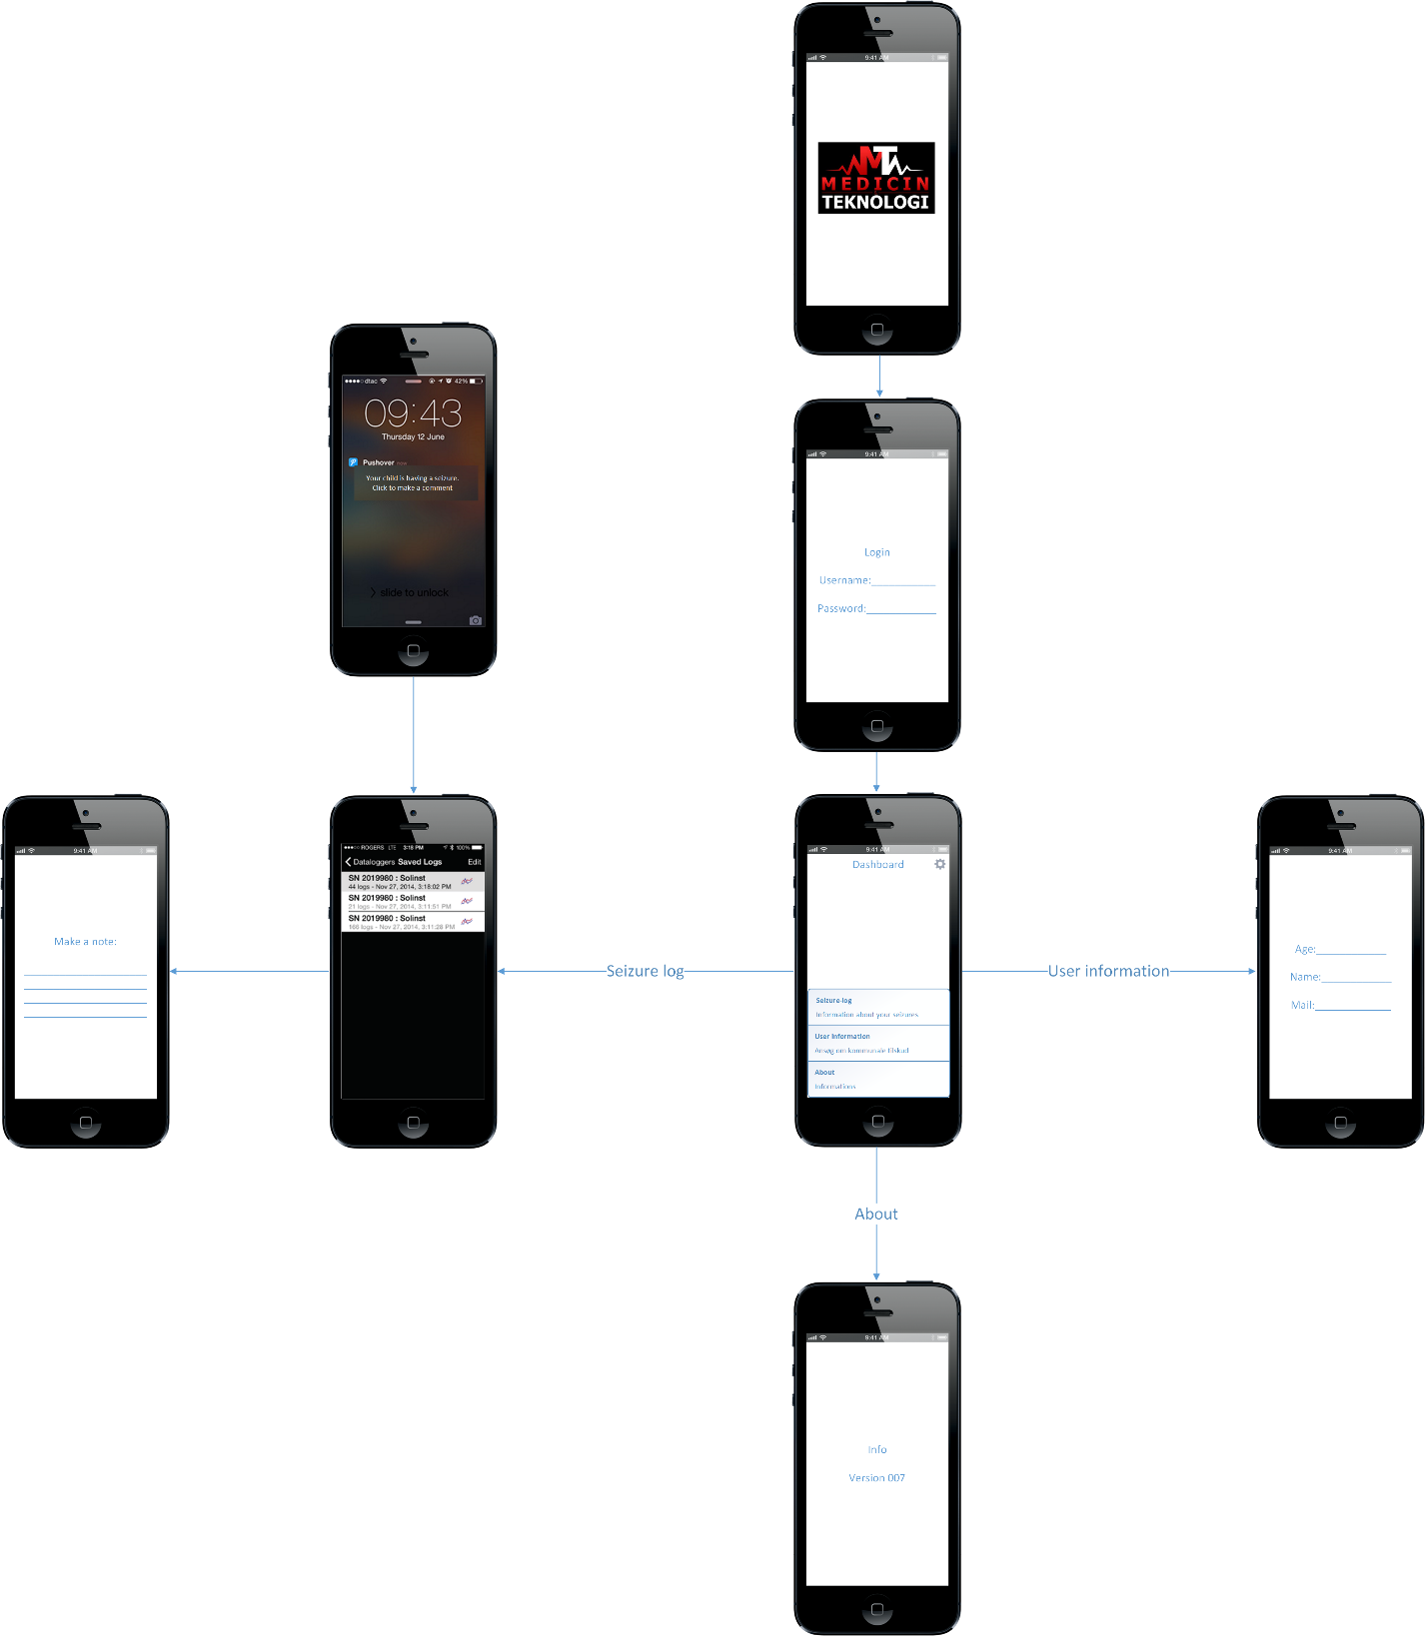
Flow chart

Slide 4
To do
Highest priority (today)
Buy coffee.
Optimize Matlab code.
Define final layout.
Setup github accounts.
To Thursday.
Implement FFT in Java
Filter in Java
Extract filter coefficients from Matlab.

